Slide 1
MECALS
Final Lab Presentation
14.03.2017 Jönköping

Slide 2
Overview
Context
Motivation
Team Reports
Demo
Summary
Lab Retrospective

Slide 3

Context
SAMO
ATCO, Shift-Managers, Flight surveillance
Cardreaders, CALS and NARMS to log work time
SAFAPS to calculate health scores
Notes:
State Airspace Management Organisation
Air Traffic Controller
Controller Automated Logging System
New ATCOs Reporting and Monitoring System

Slide 4
Motivation
Cardreaders breaking down
Replace with mobile phones
Lower costs
Enabler for future use cases

Slide 5
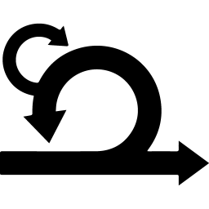


Lab settings
8 weeks
6 teams
Scrum
Notes:
8 weeks with sprints each week
Team switch after 5 weeks
Teams are: architecture, 2x dev, test, management and legacy
target deliverables: MECALS, AD, DevOps infrastructure, Documentation

Slide 6
Team Management
Product Owner and Scrum Master
Tasks
Requirements and Business Value Analysis
Scrum Management
Project Management (not part of Scrum)
Technological and Business Constraints
Neubauer Adrian
Sarda Jean
Notes:
Team Members: Adrian Neubauer (Scrum Master), Jean Sarda (Product Owner)
Two requirements documents, unified into use cases
Project constraints:
iOS on mobile (got redacted)
Windows or Unix for backend
Don‘t touch current systems (CALS and NARMS)
Use custom codes
Authentication
Proximity check (with bluetooth)

Slide 7
Use cases

Slide 8



Team tools
Github
Slack
Trello

Slide 9
Team architecture
Design architecture for system under development
Provide documentation for module interoperability
Ajay Kumar Rajamundry
Benjamin Couillaud
Onete Bogdan Gabriel
Theo Ardouin

Slide 10
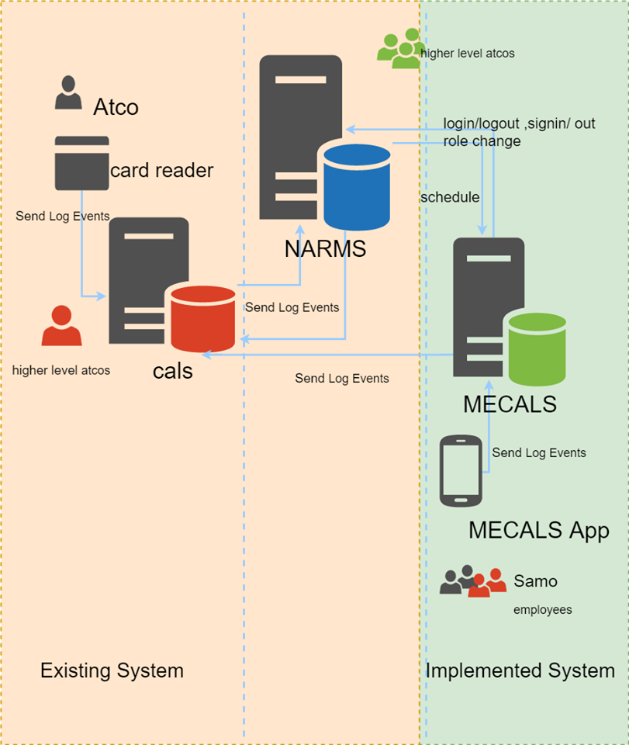
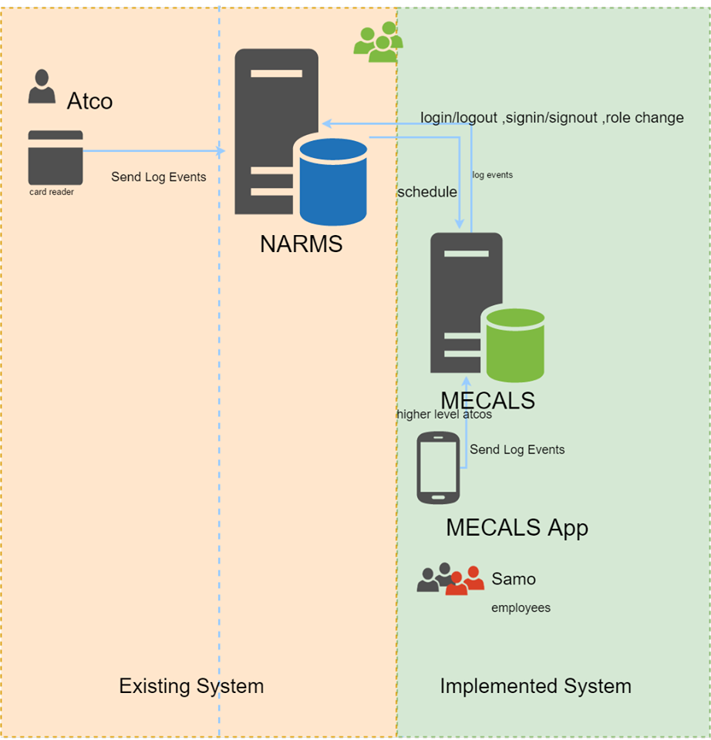
Context diagram
Notes:
When the project started, what we had to work with was the NARMS and CALS systems , along with the physical card readers. The point of MECALS is to replace the card readers , though it was decided that the card readers should be kept for the time being in case of emergencies. However , there were problems faced from the beginning. The existing documentation was poorly done , and thus took time to understand the legacy system. Yet, in the final stages of development , it was discovered that CALS , as it was , was practically useless , and thus was removed. This prompted the developer teams to rethink their approach. MECALS (and the card readers) would send data (in the form of events) directly to NARMS now.

Slide 11
Quality attributes - general
Priority | Title | Description
1 | Availability | Because of the fact that an ATCO has to manage air space then has many lives on his hands, the tools he uses must always work properly and be highly available.
2 | Security & Safety | For the same reason, MECALS must be secure and safe. A malicious attack on the system could have a several consequences.
3 | Robustness | MECALS must endure unusual situation in order to insure its first priority as the availability. Air space control depend on a hazardous environment like unpredicted delays on arrivals planning.
4 | Resilience | MECALS must endure sudden burst of load for the same reasons quoted earlier.

Slide 12
Quality Attributes - mecals
Server Quality Attributes
Application Quality Attributes
Priority | Title | Description
5 | Efficiency | The serve must be responsive.
5 | Usability | The application must be easy to use by the intended users.
Priority | Title | Description
5 | Efficiency | The mobile application must load quickly and be responsive to any device.
5 | Usability | The mobile application must be easy to use and understand by the intended users.

Slide 13
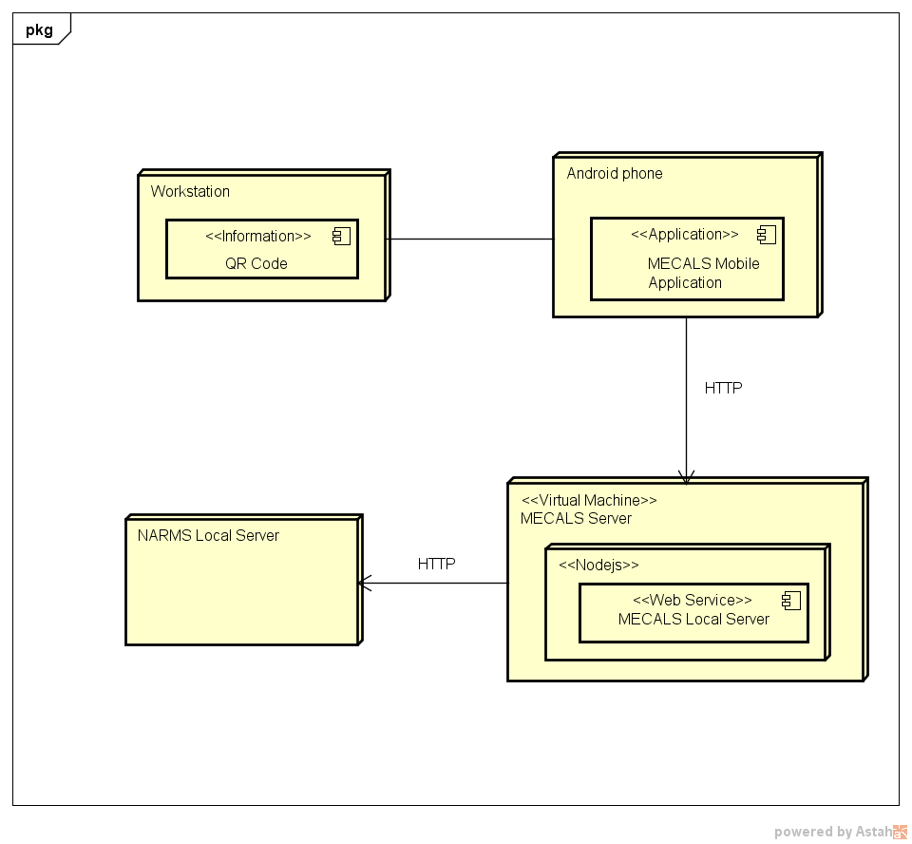
Deployment diagram
Notes:
The workstation prints on the screen a QR Code , which is scanned by the MECALS Mobile App. The workstation and the mobile phone , an android device , will communicate via Bluetooth to determine the proximity of the user’s phone. The phone then sends login requests via HTTP to the MECALS Server , which is hosted on a virtual machine. The web service will then process the request and send the data to the NARMS Server , also via HTTP.

Slide 14
Team frontend
Mobile application in Android Studio and Java
Lack of testing devices for iOS
No cross platform necessary
Travis instead of AppVeyor
Al-Ghareeb Meelad
Darchy Olivier
Deschamps Maxime
Qasim Muhammad
Notes:
There is no need for Xamarin since there will be no need for a cross-platform application (only for android).
Xamarin is platform dependent. However, since the initial decision for iOS was changed, it is no longer needed.
Travis is used instead for continuous integration. There is no need for AppVeyor since there is no iOS app.
Al-Ghareeb, Meelad
Darchy, Olivier
Deschamps, Maxime
Qasim, Muhammad

Slide 15
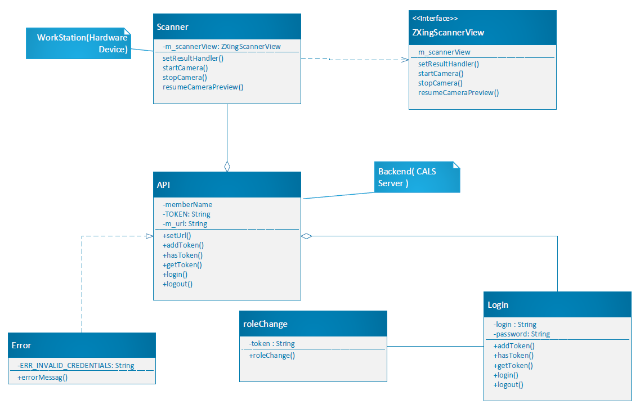
Team frontend

Slide 16
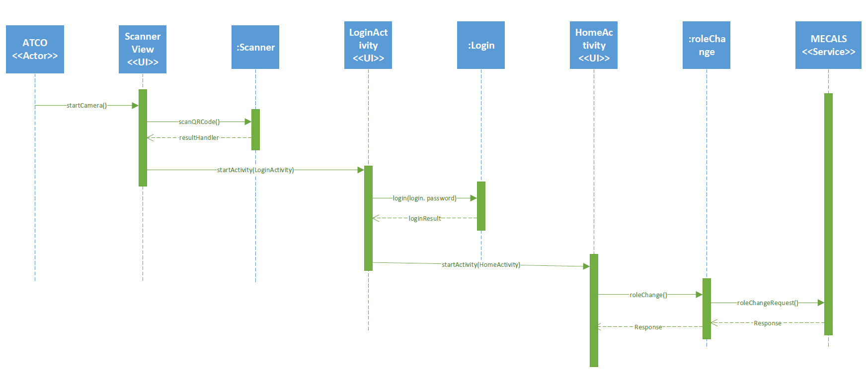
Team frontend

Slide 17
Team backend
Business and logging logic
Communicates with NARMS
Carlsson Fredrik
Eriksson Klas-Göran
Milox Thomas
Prenat Hugo

Slide 18


Technology choice

Slide 19
Initial backend architecture

Slide 20
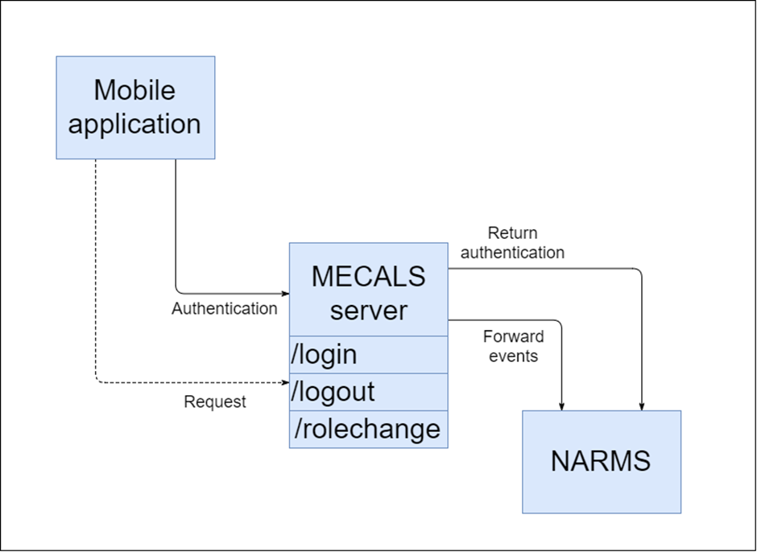
Current backend architecture

Slide 21
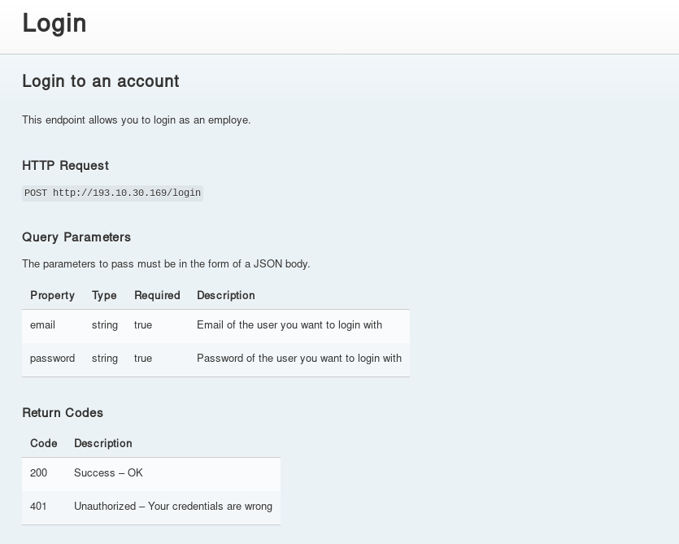

API
https://spa-mecals.github.io/slate

Slide 22
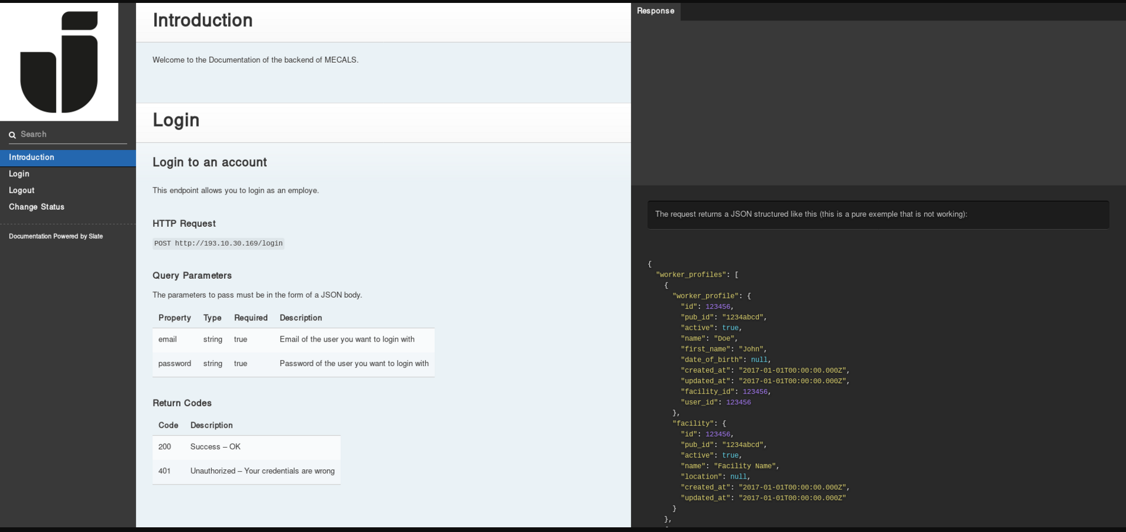
Team backend

Slide 23
Team tester
Continuous Integration
Continuous Deployment
Darsi Venkata Narayana
Kasprzak Milan
Lacour Arthur
Nirmal Kumar

Slide 24



Continuous integration
Each push…
… on the GitHub repository…
… triggers a build.

Slide 25


Automatic deployment
If (and only if) the build is successful…
… the sofware is uploaded via FTP to the server, where it’s automaticaly launched,

Slide 26


Android Application
Travis can build and even run Android application…
…using the chosen Android API and the gradle build script

Slide 27
demo

Slide 28
Lab retrospective
Definition of done and team contract
Challenges
No iOS devices
False documentation
CALS broken
Points to optimize
Team communication
Work dependencies
Notes:
Team A waiting for results of Team B to continue to work on it
People missing

Slide 29
Deliverables (appendix)
Architectural Description
Documentation
Repositories
Development Infrastructure

Slide 30
Question?

Slide 32
Lab participants
Team Architects
Ardouin, Théo
Couillaud, Benjamin
Onete Bogdan, Gabriel
Rajamundry Ajay, Kumar
Team Front-End Developers
Al-Ghareeb, Meelad
Darchy, Olivier
Deschamps, Maxime
Qasim, Muhammad
Team Back-End Developers
Carlsson, Fredrik
Eriksson, Klas-Göran
Milox, Thomas
Prenat, Hugo
Team Darter (Testers)
Darsi, Venkata Narayana
Kasprzak, Milan
Lacour, Arthur
Nirmal, Kumar
Team Management
Neubauer, Adrian (Scrum Master)
Sarda, Jean (Product Owner)
Team NARMS
Rolland, Paul
Atokaran, Edwin Thomas
Ganta, Jitendra

Slide 33
Image sources
http://www.clipartbest.com/cliparts/eiM/Apb/eiMApbAyT.png
https://image.freepik.com/free-icon/group-of-people_318-31923.png
http://plainicon.com/dboard/userprod/2800_a1826/prod_thumb/plainicon.com-50316-256px-6fb.png
https://image.freepik.com/free-icon/circular-clock-symbol-for-interface_318-60392.jpg
https://assets-cdn.github.com/images/modules/logos_page/GitHub-Mark.png
https://lh3.googleusercontent.com/CzlsZP3xUHeX3HAGdZ2rL9mK6_C-6T1-YWeBeM8nB3ilmfPSBHCFx4-UbQr8MnQms3d9=w300
http://seeklogo.com/images/T/trello-logo-CE7B690E34-seeklogo.com.png
https://upload.wikimedia.org/wikipedia/commons/7/7e/Node.js_logo_2015.svg
https://raw.githubusercontent.com/lord/img/master/logo-slate.png
https://git-scm.com/images/logos/downloads/Git-Logo-2Color.png
https://s-media-cache-ak0.pinimg.com/originals/3c/d5/67/3cd5679f54dc60811383649f9f6ea37d.png
https://cdn.travis-ci.com/images/logos/TravisCI-Full-Color-45e242791b7752b745a7ae53f265acd4.png
http://www.clippingpathhouse.com/images/ftp.png
https://image.freepik.com/free-vector/android-boot-logo_634639.jpg
http://fundacionjala.github.io/enforce-gradle-plugin/img/gradle.png

